Slide 1
Introduction to Visualization

Slide 2
Agenda
Introduction to Visualization
Visualisation for Data Science
Introduction to Matplotlib and Seaborn
List of plots in Matplotlib
List of plots in Seaborn
Summary
Hands on

Slide 3
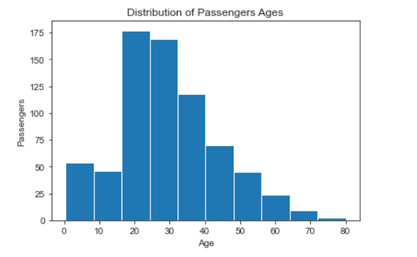
Visualization
Visual description of data
Provides better understanding of data.
Helps to explore patterns, trends, and correlations.
Helps to present reports, outcomes, and inferences in visual format.
Visualisation is a very important part of Data Science.

Slide 4
Visualization for Data Science
In data science, visualisation is used to analyse the features and derive insights from the raw data.
Visualization is also used to report the findings in a presentable format.
Uses of visualisation for data science include:
For understanding distribution of features
For statistical analysis of data
For finding trends and patterns
For checking relationships among features
For presenting findings in visual graphs

Slide 5
Introduction to Matplotlib and Seaborn
Matplotlib:
It’s a most popular python library for visualization.
It is built on NumPy arrays, its free and open source library.
Supports wide variety of methods and functions to plot different types of graphs.
Seaborn:
It is build on top of Matplotlib.
It is integrated with Pandas data structures.
Seaborn makes statistical plots more attractive.
It uses simple syntax which is easy to understand compared to Matplotlib.

Slide 6
List of plots in Matplotlib
It helps in understanding the trend of the variable. Generally used for a single continuous variable or two continuous variables.
Line plot
Basic Plots
It is a classic and most commonly used plot to study the relationship between two random continuous variables.
Scatter plot
It helps to understand and compare the distribution of different levels in a variable. Generally used for a categorical variable or a combination of categorical and continuous variable.
Bar plot
Notes:
Diagram Created Internally

Slide 7
List of plots in Matplotlib
It helps in visualizing the distribution of a variable. It displays the distribution of the data based on five number summary.
Box plot
Statistical Plots
It helps in visualizing the discrete or continuous data and understand its distribution pattern.
Histplot
It is a circular statistical plot. It displays the percentage of observations of different categories in a variable.
Pie Plot
Notes:
Diagram Created Internally

Slide 8
List of plots in Seaborn
It helps in understanding the variation in the data distribution. Provides access to several approaches for visualizing the distribution of a continuous variable.
Displot
Distribution plots
It represents the distribution of one or more variables by counting the number of observations that fall within discrete bins.
Histplot
A kernel density estimate (KDE) plot helps in visualizing the data distribution, analogous to a histogram. It represents the data using a continuous probability density curve.
KdePlot
Notes:
Diagram Created Internally

Slide 9
List of plots in Seaborn
It is similar to barplot. It displays the number of observations in each categorical level using the bars.
CountPlot
Categorical plots
Catplot
helps to visualise the categorical data much efficiently, Can be used to plot multiple plots like count, box, strip, swarm by changing the ‘kind’ argument.
Notes:
Diagram Created Internally

Slide 10
List of plots in Seaborn
helps to understand the complicated comparisons much easier.
Relational plots
Can be used for analysis between categorical features and a numerical feature.
RelPlot
By default the type of the plot is scatterplot().
We can change the type of the plot by changing the ‘kind’ parameter.
Notes:
Diagram Created Internally

Slide 11
List of plots in Seaborn
Pandas corr() method - generates correlation matrix, sns.heatmap() - helps to visualize correlation values.
Heatmap
Matrix Plots & Multi Grids
It creates multiple instances of the same plot on different subsets of the data.
Facetgrid
It creates an axis grid and each variable is represented on y-axis and x- axis. Pairwise relationship is represented through scatter plots and distribution is shown through displot.
Pair Plot
Notes:
Diagram Created Internally

Slide 12
Hands on
Case Study: Data Analysis using visualization
Objective: to explore the Titanic dataset by performing data analysis using visualization. We will implement different plots supported by matplotlib and seaborn on the titanic data and derive some meaningful insights.
Dataset Description:
The sinking of the Titanic is one of the most infamous shipwrecks in history.
On April 15, 1912, during her maiden voyage, the widely considered “unsinkable” RMS Titanic sank after colliding with an iceberg. Unfortunately, there weren’t enough lifeboats for everyone onboard, resulting in the death of 1502 out of 2224 passengers and crew.
While there was some element of luck involved in surviving, it seems some groups of people were more likely to survive than others.
In this case study, we will try to answer the question: “what sorts of people were more likely to survive?” using visualisation methods on the passenger data (ie age, gender, socio-economic class, etc).

Slide 13
Hands on
Steps:
Basic exploration to understand the data
Use an appropriate plot to answer from which port the maximum number of people boarded the titanic?
Check if there is any relationship between fare and age?
Check the percentage of male and female passengers and their survival rate?
Check the distribution of the males and females among different ticket classes?
Analyse the relationship between Ticket classes, Survival rate, and Gender of the passengers using appropriate plot

Slide 14
Summary
In this module we discussed:
Importance of visualization
Matplotlib and Seaborn Libraries in Python
Different plots associated with Matplotlib
Different plots associated with Seaborn
Notes:
Diagram created Internally

Slide 15
Thank you Happy learning ☺

